Slide 1
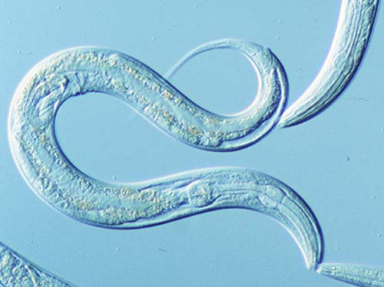
Worms Like Drugs Too!
Behavioral Neuroscience in
Caenorhabditis elegans
Bethany Neal-Beliveau, PhD
Department of Psychology
IUPUI School of Science
Notes:
“sē-nō-rab-ˈdīt-əs” – aka C. elegans

Slide 2
Why Study Drug Addiction?
Total costs of drug abuse and addiction due to use of tobacco, alcohol and illegal drugs are estimated at $740 billion a year [NIDA, 2017].
  illicit drug use alone accounts for $193 billion in health care, productivity loss, crime, incarceration and drug enforcement (prescription opioids – $78.5 billion)
Drug addiction is a chronic and relapsing brain disease characterized by compulsive drug use despite serious negative consequences.
  few who indulge in drug-taking behavior become addicted

Slide 3
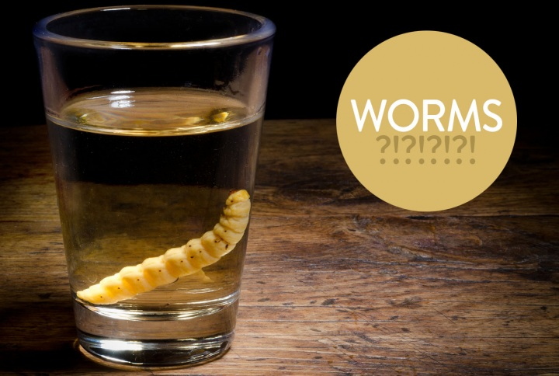
Understanding the biological alterations occurring as a result of drug use or exposure may help in treatment and prevention of addiction.

Slide 4
Need for Animal Models
For ethical reasons, it is difficult to determine the effects of alcohol and other drugs of abuse in humans.
Animal studies can ensure that subjects are only exposed to the drug of interest, whereas humans often expose themselves to multiple drugs at one time.
  can determine if effects are due to a specific drug
  can also control exposure time and amount
  can control nutritional status and other potential confounding variables
Notes:
.

Slide 5
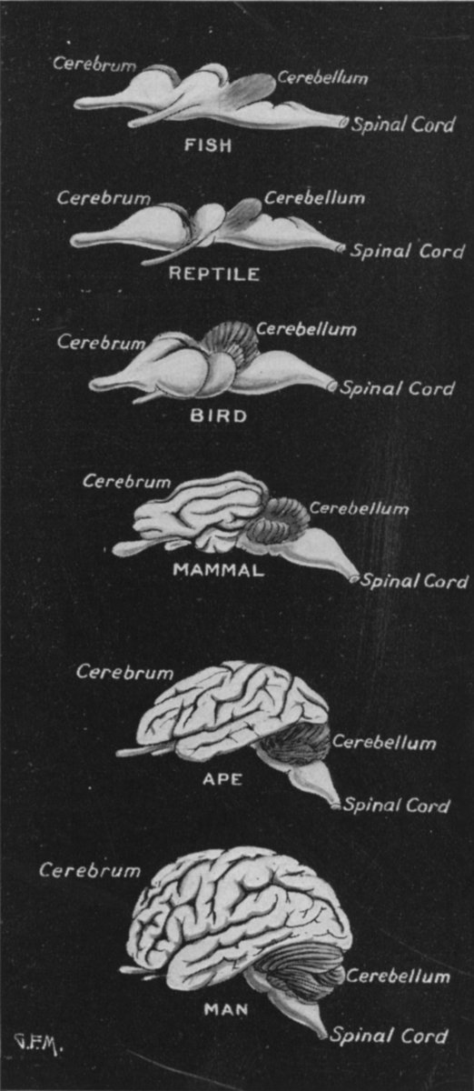
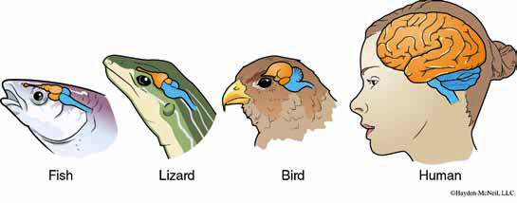
Brain Evolution
Evolution of nervous systems:
  Darwin – evolution by natural selection
  nervous systems of different species may share common mechanisms
  rationale for “animal models”
  adaptations are reflected in the structure and function of the brain of every species
  invertebrates

Slide 6
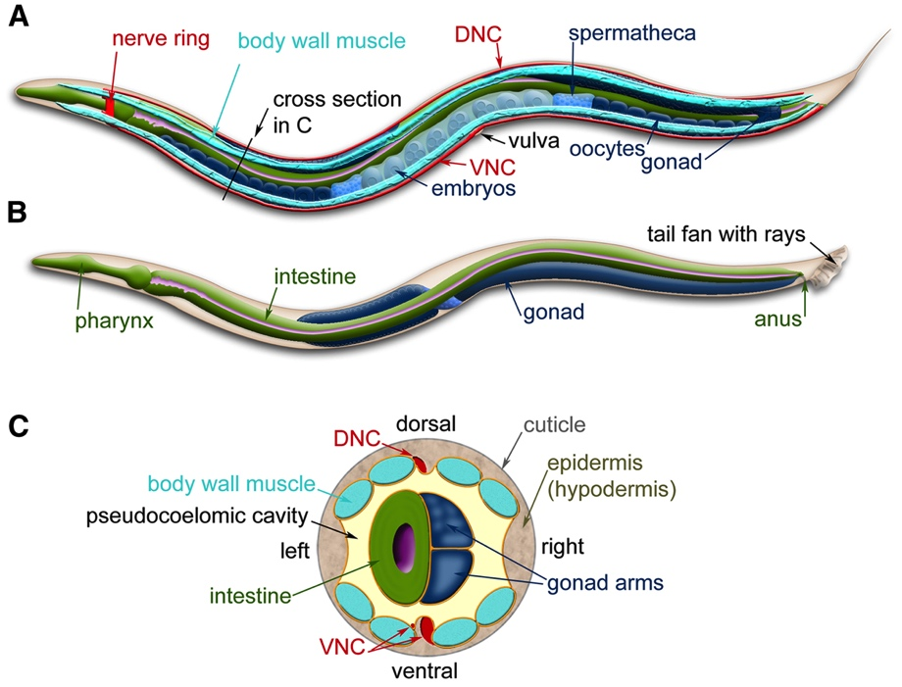
What are C. elegans?
Round worm (nematode)
Non-hazardous, non-infectious, non-pathogenic, non-parasitic
Found in soil and feed on bacteria
Diploid, hermaphrodite and male (self- and cross-fertilization)
3-day generation time
Approx. 1.0 mm in length
Life span: 2-3 weeks

Slide 7
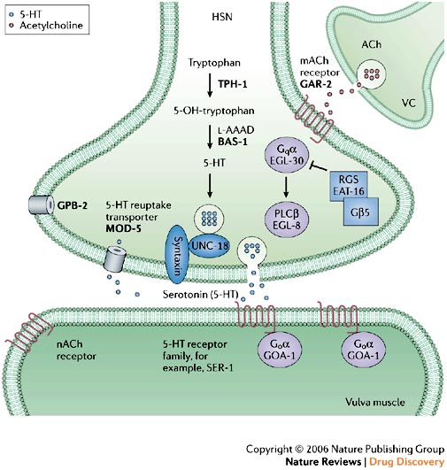
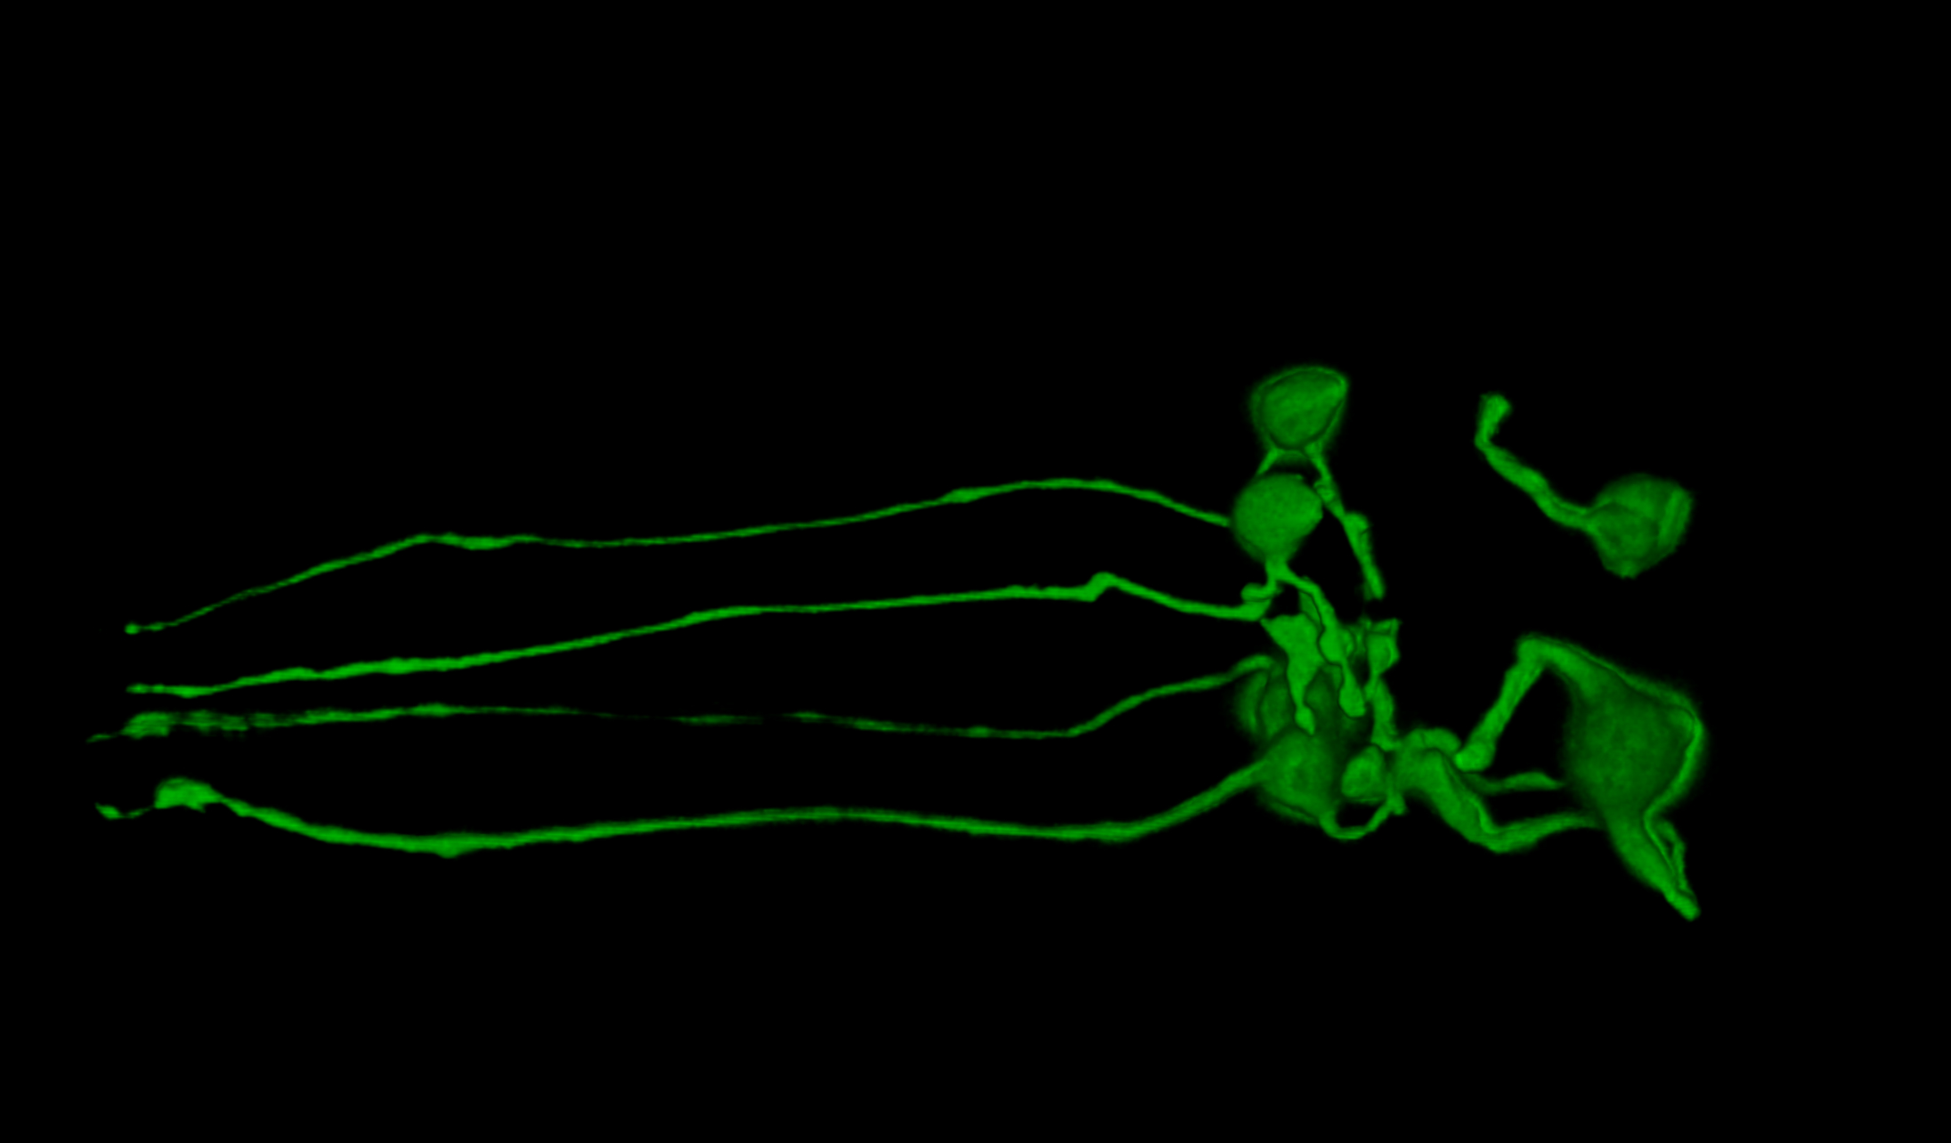
Why Use C. elegans?
Neurobiology is simple and well described
  959 somatic cells; 302 neurons
  approximately 5000 synapses
Conserved molecular systems
  dopamine, serotonin, GABA, glutamate, acetylcholine, endogenous opioids, etc.
  ion channels, G-proteins, 2nd messenger systems
Powerful genetic tools
  mutants; RNAi; transgenic approaches
  genome fully sequenced – 19,000 genes
Notes:
The worm has a short 3-day generation time, completely sequenced genome of around 19000 genes, and 302 neurons making roughly 5000 synapses. Although simpler than mammals, this nervous system has shared molecular foundations with those of mammals. Making the use of this invertebrate model applicable to vertebrates. In addition, as we are able to cultivate the worms ourselves in the lab with low maintenance the cost is relatively inexpensive, making this model of drug study ideal.

Slide 8
C. Elegans Behavior
Capable of associative learning
  chemosensory cues, temperatures and varying pH levels can serve as conditioned stimuli (for review, see Ardiel and Rankin, 2010)
Focused on finding food and avoiding danger
Our studies:
  can drugs of abuse “hijack” these systems in ways similar to that seen in higher level organisms and humans?

Slide 9
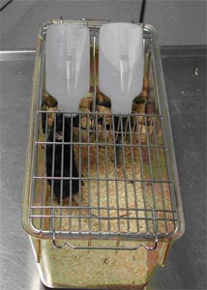
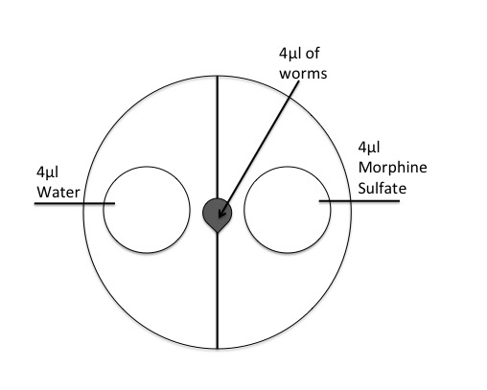
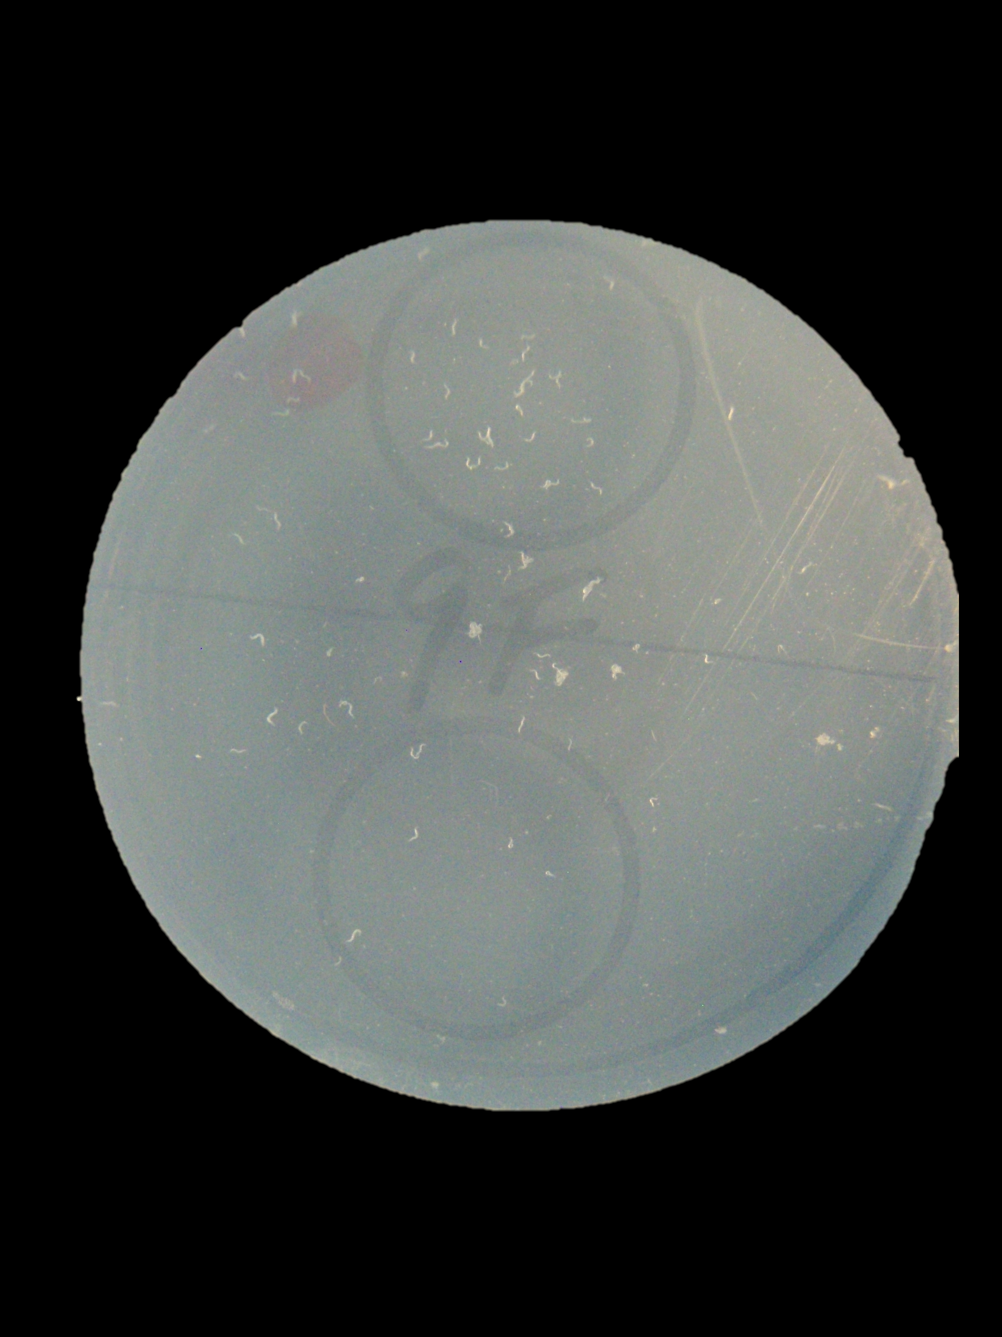
Preference Testing
Two bottle choice procedure. The animals had free access to 8% ethanol solution and water. From Zimmer, 2008
Example of a drug preference testing plate. Worms are placed at the center of the agar plate and allowed to roam freely.

Slide 10
Preference for CB Agonist
For access to the video, contact me at bnealbe@iupui.edu

Slide 11
Morphine

Slide 12
Ethanol

Slide 13
Context (Place) Conditioning
Will C. elegans exhibit context conditioning with a drug as a stimulus?
  are they able to learn an association between a psychomotor stimulant and an environmental stimulus?
  do they exhibit a place preference for the drug (i.e., do they find the drug “rewarding”)?

Slide 14
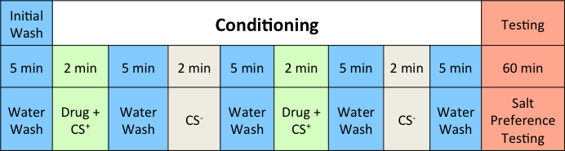
Conditioning Procedure
MAP salt-cue conditioning procedure in N2 adult C. elegans. Worms were washed off plates with water and transferred to 15 ml centrifuge tubes. First, worms were washed with water for 5 min followed by a 2 min wash in a conditioning solution (Drug + CS+). Then worms were washed with water again for 5 min followed by a 2 min wash in a conditioning solution without drug (CS-). This cycle was then repeated. Following this conditioning procedure, worms were washed off filters into 15 ml tubes and the supernatant was removed. Worms were then pipetted into the center of each well of a 6-well testing plate and images of each well were taken 60 min after placing worms on test plates that contained the ion (CS+) on one side and vehicle (CS-) on the other.

Slide 15
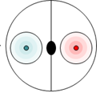
Expectations of MAP Paired with CS+ Context
Test Plate After 60 Minutes
If the worms find the drug rewarding
If the worms DO NOT find the drug rewarding
If the worms find the drug aversive
CS+ CS-
Remember: Drug is not present on test plate – only the conditioning ions.

Slide 16
MAP Exposure & Preference
Mean (± SEM) salt context preference for MAP conditioning. The 17 µM and 500 µM drug pairings produced significant preference for the paired ion during testing. However, for the MAP pre-exposed groups, there was no significant effect of MAP conditioning dose on the preference index.

Slide 17
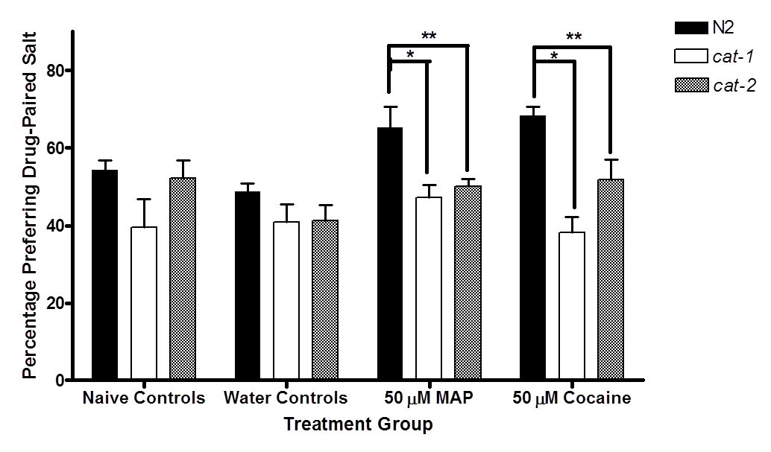
Dopamine Mutants
Effect of deletion of genes for the vesicular monoamine transporter (cat-1) and tyrosine hydroxylase (cat-2) on conditioned preference for MAP and cocaine. Asterisks indicate a significant decrease in preference compared compared to wild-type (control) worms (N2).

Slide 18
Summary & Conclusions
C. elegans exhibit responses similar to what is seen in humans and other vertebrates:
  display a significant preference for methamphetamine, cocaine, ethanol, morphine, nicotine, a CB1 agonist, and other drugs of abuse.
  display a significant decrease in drug preference following pretreatment with naltrexone (Revia; Vivitrol).
  display reward behavior following context conditioning that appears to be dopamine-dependent.
Current studies focus on identifying the underlying neural mechanisms of these behaviors, as well as examining potential pharmacotherapies for drug and alcohol addiction.

Slide 19
Acknowledgements
Drs. Eric Engleman and Simon Katner, IUSM Dept. of Psychiatry
Corey Calhoun – IPREP Fellow
Heather Musselman, former Addiction Neuroscience graduate student, IUPUI Dept. of Psychology
Former and current undergraduate students:
  Carly Guest-Williams, Kirk Ralston, Kyle Huskins, Avneet Kaur, Bryce Tomlinson, Harjot Kauer, Kevin Steagall, Kristin Bredhold, Michaela Breach
Funding: Vice Chancellor for Research’s Office; NIAAA; NIDA; IUPUI Dept. of Psychology; IUSM Dept. of Psychiatry

