Slide 1
Standard 5: Personality, Assessment, and Stress
Mrs. Amanda Harmon
Zionsville Community High School
Psychology Day – IUPUI
November 1, 2019

Slide 2
Standard 5: Personality, Assessment, and Stress
Students recognize that personality is the distinctive and relatively stable pattern of behaviors, thoughts, motives and emotions. Students also identify the different types and functions of assessment instruments.
This Standard has 6 Proficiencies. This set of lesson ideas includes materials that can be completed in six, 50-minute class periods (one Proficiency per day) or three, 90-minute blocks (two per day). An extension activity is also included.

Slide 3
P.5.1 Identify the major psychologists involved in the study of personality
Bell Ringer: Complete the sentence “I am _____” with 15 personality traits.
After 2-3 minutes, as a class, we will discuss their responses.
This process will involve:
Eliminating statements like: “I am hungry,” “I am tired,” or “I am bored,” and
Focusing on statements like: “I am easy going,” “I am shy,” or “I am dependable.”

Slide 4
P.5.1 Identify the major psychologists involved in the study of personality
Name of Theory | Name of Theorist(s) (if applicable) | Summary of Theory | Tests or measures used with the theory (if applicable)
Psychodynamic
Trait
Social-Cognitive

Slide 5
P.5.1 Identify the major psychologists involved in the study of personality
Exit Question/Writing Prompt:
Real Self vs. Ideal Self
Look back at the personality traits you identified earlier. Do you see any that differ from when you were a child? Why do you think those changes occurred?
Are there any you would like to change now, if you could? Which ones are they, and why would you like to change them?

Slide 6
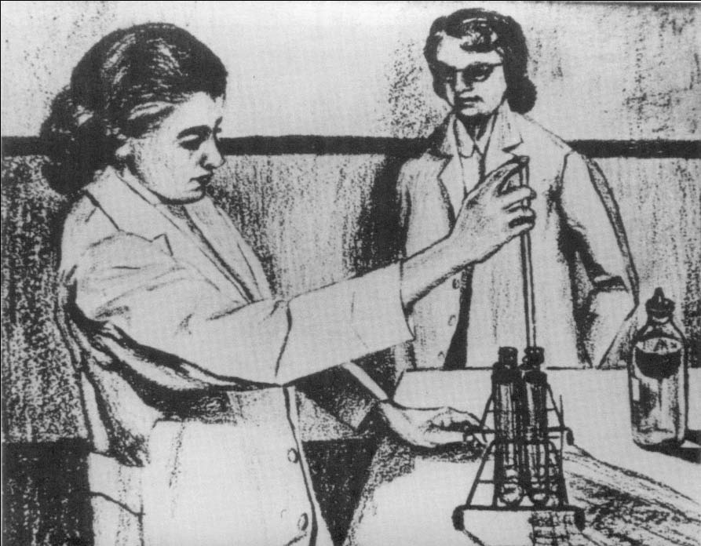
P.5.2 Distinguish between objective and projective techniques of personality assessment, and give examples of each.
Look at the picture. Write a complete story about it. Imaginative. With a beginning, middle, and an end. Portray who the people might be, what they are feeling, thinking, and wishing. What led to the situation depicted in the picture? How will everything will turn out in the end?
Examine the picture for several seconds before writing. You will have 10 minutes to write your story. Write continuously the entire 10 minutes. If you need more than 10 minutes, feel free to continue.
Bell Ringer - Thematic Apperception Test
http://www.utpsyc.org/TATintro/

Slide 7
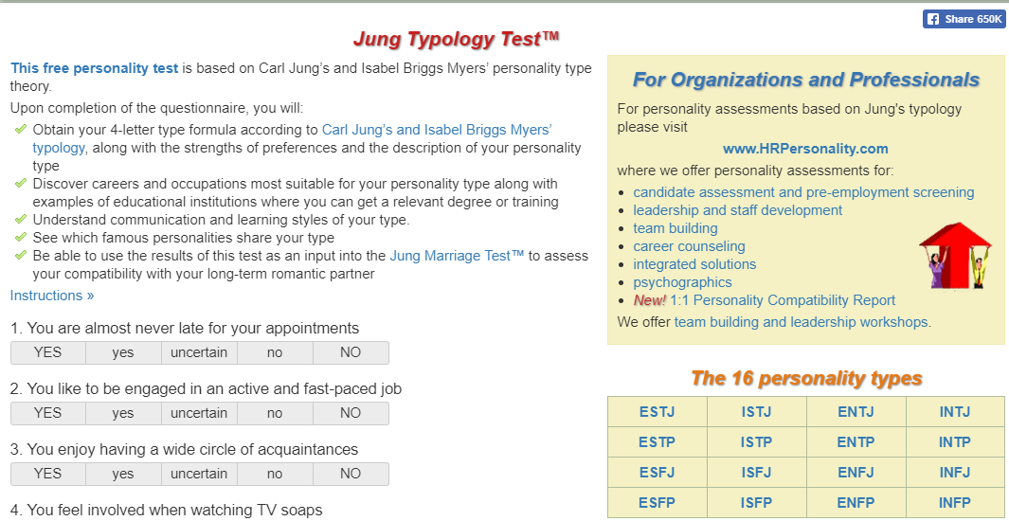
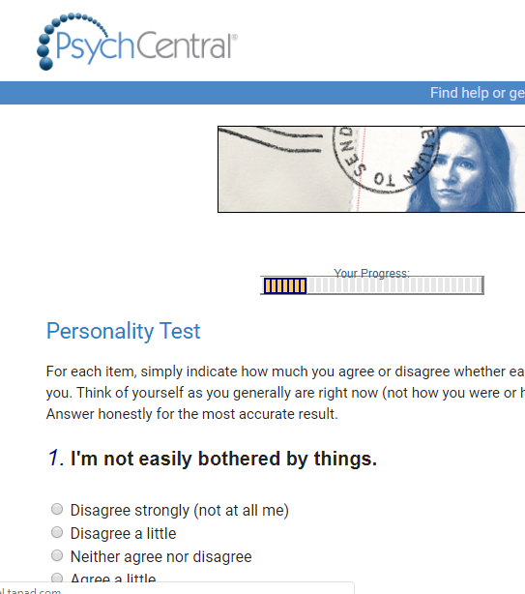
P.5.2 Distinguish between objective and projective techniques of personality assessment, and give examples of each.
How do these tests differ? What are the pros and cons of each type of test?
MBTI, Rorschach, Big 5
http://theinkblot.com/
https://psychcentral.com/personality-test/start.php
http://www.humanmetrics.com/cgi-win/jtypes2.asp

Slide 8
P.5.3 Distinguish between stress and distress.
Bell Ringer:
What is the most stressful thing that you’ve done today that you can share in class? What’s the most stress reducing activity you’ve engaged in today that you can share in class?

Slide 9
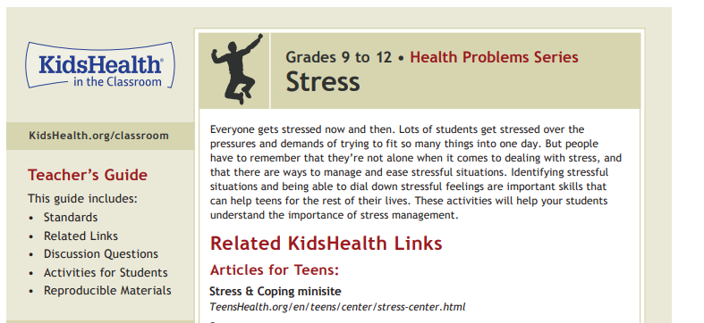
P.5.3 Distinguish between stress and distress.
https://classroom.kidshealth.org/classroom/9to12/problems/emotions/stress.pdf

Slide 10
P.5.4 Identify environmental factors that lead to stress.
Bell Ringer: Stress can be categorized into different types:
Daily Stress
Significant Changes
Catastrophes
What are 5 examples you think might fall in each of these categories based on their names?

Slide 11
P.5.4 Identify environmental factors that lead to stress.
Make a list of:
Stress Producers and
Stress Reducers.
Discuss techniques we can use to relieve stress.
https://www.youtube.com/watch?v=OWStPsq2l0w

Slide 12
P.5.4 Identify environmental factors that lead to stress.
Exit Assignment:
What is a stressor in your life that you could try to eliminate?
If you can’t get rid of the stress producer, what could you do to reduce the stress it is causing you?

Slide 13
P.5.5 Explain Hans Seyle’s General Adaptation Syndrome (GAS)
Bell Ringer:
What happens when you’re faced with a daily stressor? How do stressors generally affect you?

Slide 14
P.5.5 Explain Hans Seyle’s General Adaptation Syndrome (GAS)
https://www.medicalnewstoday.com/articles/320172.php
Have students read the article above. Then, have the students take on the role of a journalism student and write an article that would be suitable for a school newspaper. The topic should be a common teen stressor and how a student facing that stressor may progress through the three phases: Alarm, Resistance, and Exhaustion, as well as some stress-reducing tips.

Slide 15
P.5.6 Evaluate the influences of variables, such as culture, family, and genetics, on personality development and identify the psychologists associated with each.
Bell Ringer:
Have you ever noticed that you reveal different aspects of your personality, depending on who you’re with? Give an example.

Slide 16
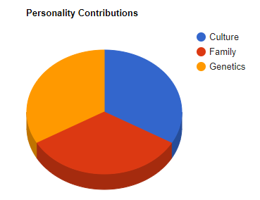
P.5.6 Evaluate the influences of variables, such as culture, family, and genetics, on personality development and identify the psychologists associated with each.
In groups of 3, have students jigsaw the variables listed that contribute to personality development, each taking one variable. For the variable they are assigned, have them identify psychologists who have researched the contributions of their variable to personality development and what they have found. They will share their findings with the group. As a group, brainstorm other variables that may contribute to the development of personality.

Slide 17
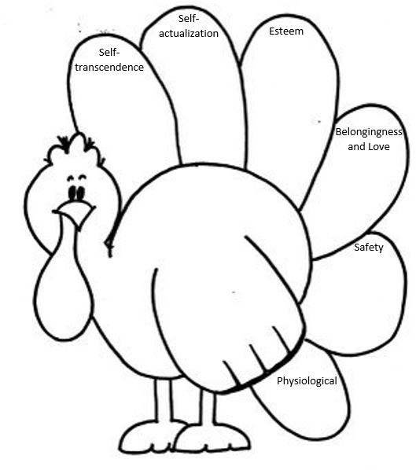
Extension Activity – Part 1
Turkey-archy of Gratitude
Some aspects of personality can be revealed using Maslow’s Hierarchy of Needs and Martin Seligman’s research on Positive Psychology. On each feather, identify things you are thankful for in your life that relate to the topics on the hierarchy.

Slide 18
Fun Extension Activity – Part 2
Expressing gratitude may make you a happier person. Studies show gratitude positively correlates with joy, happiness, and life satisfaction. Select one person who has made a major positive difference in your life. Perhaps someone to whom you have never fully expressed your thanks. Think about people who may have gone out of their way to help you, offer encouragement, or who have given you an opportunity. This may be a teacher, coach, friend, or family member. Write a one page-long testimonial on what that special person did and how they had a positive effect on you. Take your time. Thank them for their impact on your life. Try to be as specific as possible.
** One of the best gifts you can give someone is gratitude - if you feel comfortable enough share a copy of this with them.

